Slide 1

IoT
(Internet of Things)
LPWAN
(Low Power Wide Area Network)
Data Analytics
Notes:
To replace this picture, just select and delete it. Then use the Insert Picture icon to replace it with one of your own!

Slide 2
IoT, LPWAN, Data Analytics
IoT is all about connecting things using LPWAN connectivity to create smart connected world using new technology over Wide Area Network.
Low-power WAN (LPWAN) is a wireless wide area network technology that interconnects low-bandwidth, battery-powered devices with low bit rates over long ranges.
LPWANs operate at a lower cost with greater power efficiency than traditional mobile networks.
True business value of the IoT lies in Data Analytics (DA), a process used to examine big and small data sets with varying data properties to extract meaningful conclusions which are usually in the form of trends, patterns, and statistics that aid business organizations in effective decision-making processes.

Slide 3
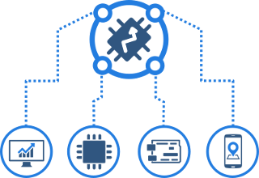
IoT Cloud Platform
Cloud Platform for intelligent IoT services
Cloud IoT is a set of fully managed and integrated service platform which will enable end to end controlling and monitoring of objects.
Products can be build which will enable City, Building & Other public/private Infrastructure to become Smart.
Enterprise Consumers, Government bodies, Defense & multinational organizations will be able use this services.

Slide 4
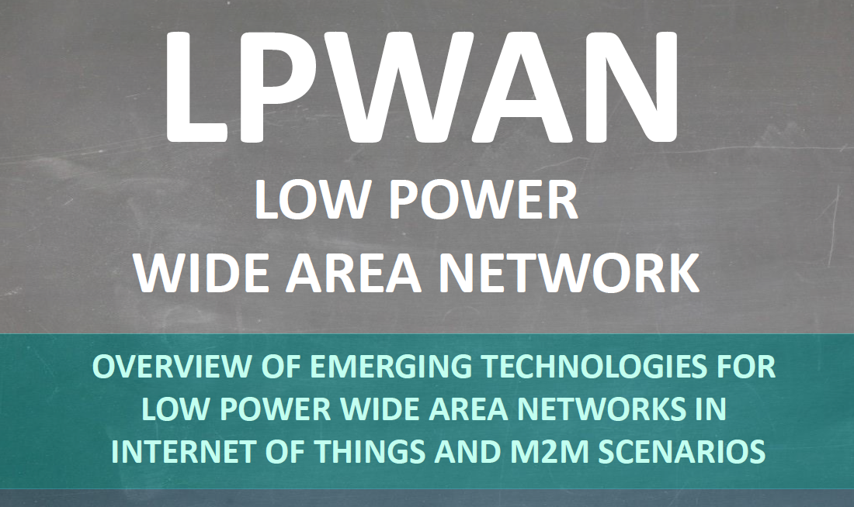
LPWAN - Wireless Connectivity

Slide 5
Wireless IoT Technologies
Wireless IoT technologies
Short Range | Long Range
 | Cellular | LPWAN
WiFi | 2G (GSM) | LoRaWAN
BlueTooth | 3G (GSM/CDMA) | Weightless-N
6LoWPAN | 4G (LTE) | SIGFOX
Z-Wave | 5G | Ingenu
Zigbee | LTE Cat 0,1 & 3 | Neul
ANT/ANT+ | LTE-M1 | N-Wave
Thread | LTE-NB1
NFC | NB-IoT (non-LTE)
RFID
EnOcean

Slide 6
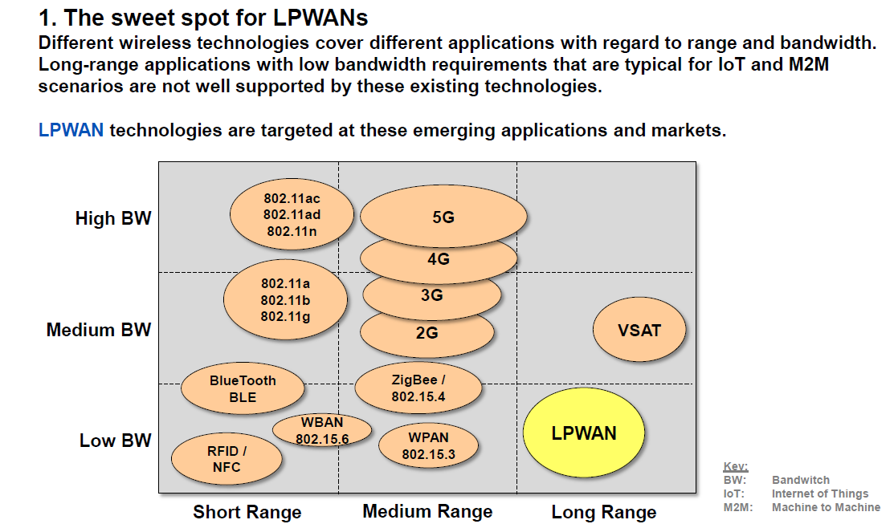
LPWAN - Wireless Connectivity

Slide 7
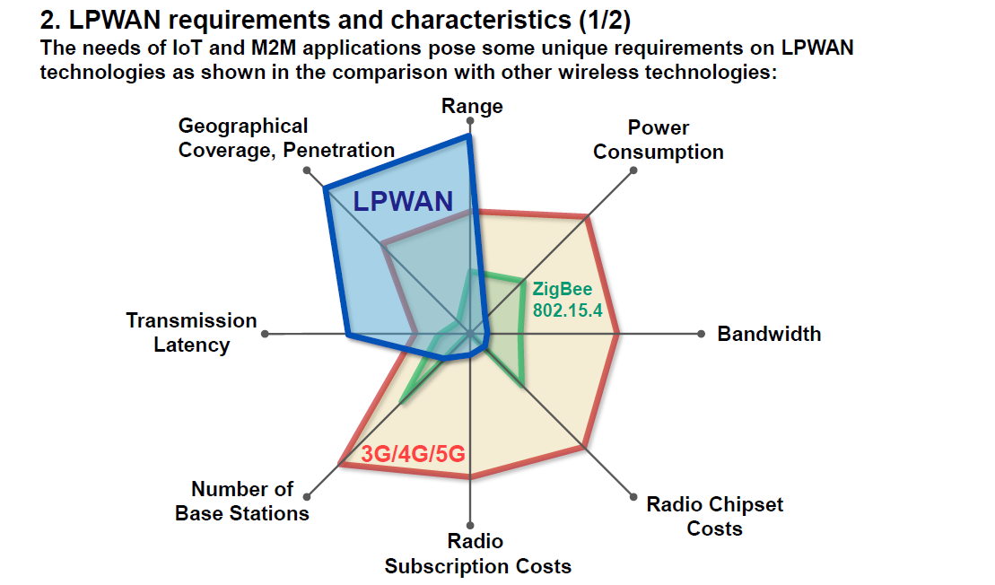
LPWAN - Wireless Connectivity

Slide 8
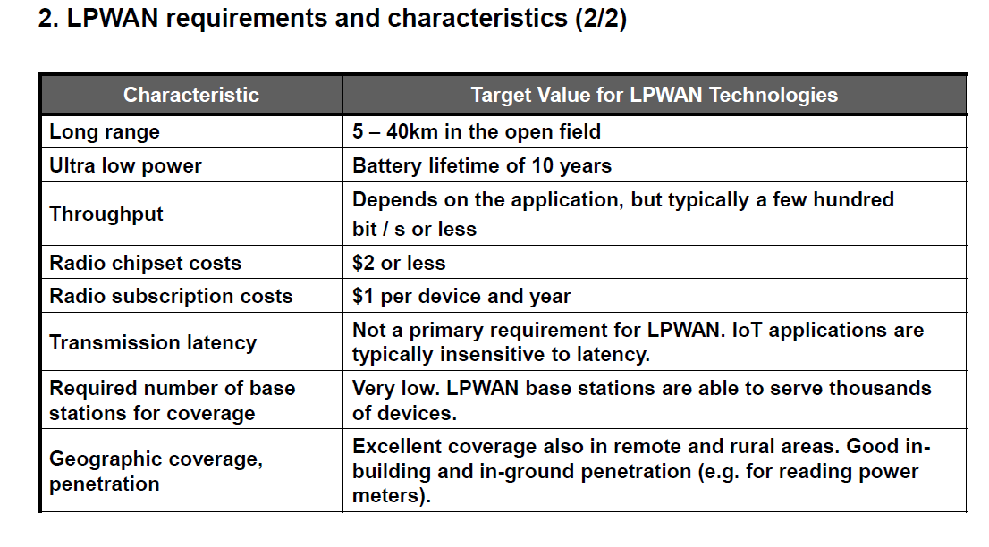
LPWAN - Wireless Connectivity

Slide 9
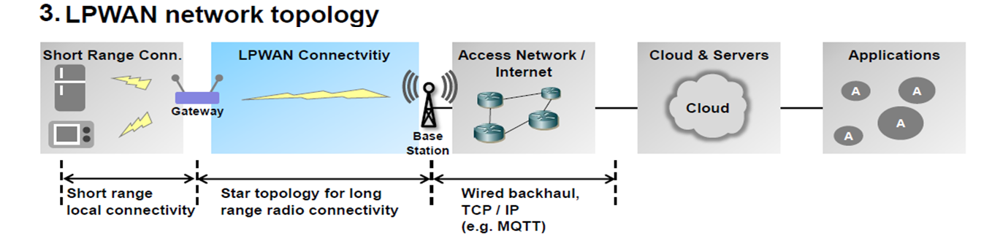
LPWAN - Wireless Connectivity
Gateway - Used for bridging connectivity to short range protocols (Zigbee, Zwave, Bluetooth etc).
Base Station – Provides connectivity to a large number of device in larger area.
Base Station is responsible for protocol translation from IoT protocols.
Traffic is backhauled to servers (Cloud) through TCP/IP based networks (Internet).

Slide 10
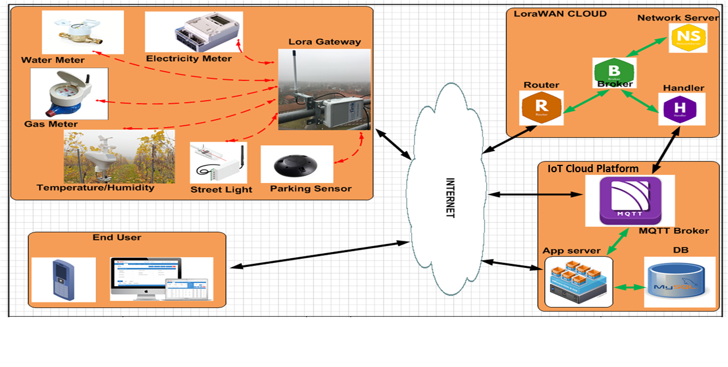
Smart City & Infrastructure Cloud Solution - LoraWAN

Slide 11
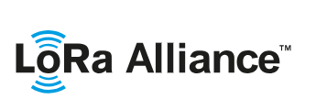
Smart City & Infrastructure Cloud Solution - LoRaWAN
LoRa Alliance WEB : lora-alliance.org
The LoRa Alliance is an open, nonprofit association formed of 500+ members since its inception in March 2015.
It is one of the largest and fastest-growing alliance in the technology sector.
Its members closely collaborate and share experiences to promote and drive the success of the LoRaWAN protocol as the leading open global standard for secure, carrier-grade IoT LPWAN connectivity.
LoRaWAN has already been deployed by major mobile network operators & private deployment globally, with continuing wide expansion into 2019 and beyond.

Slide 12
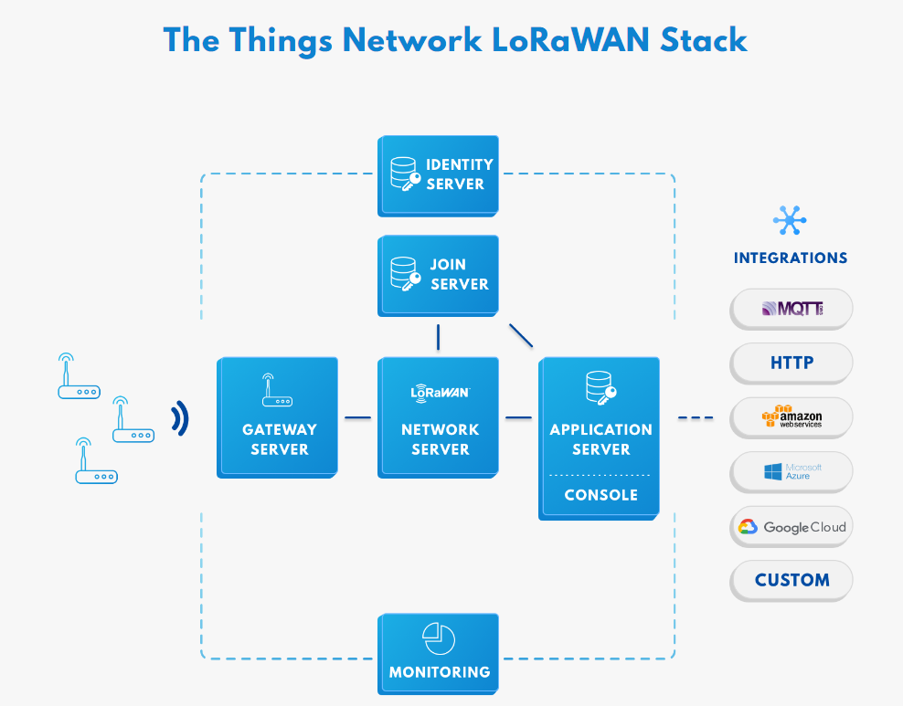
Smart City & Infrastructure Cloud Solution - LoRaWAN
https://www.thethingsnetwork.org/
TTN provide a set of open tools and a global, open network to build your next IoT application at low cost, featuring maximum security and ready to scale.
The network server can be deployed in a number of ways. Choose between the public community network, SaaS, on-premises, private cloud, embedded and offline deployments. It can be single-tenant/multi-tenant, multi-region, auto-scaling deployments.

Slide 13
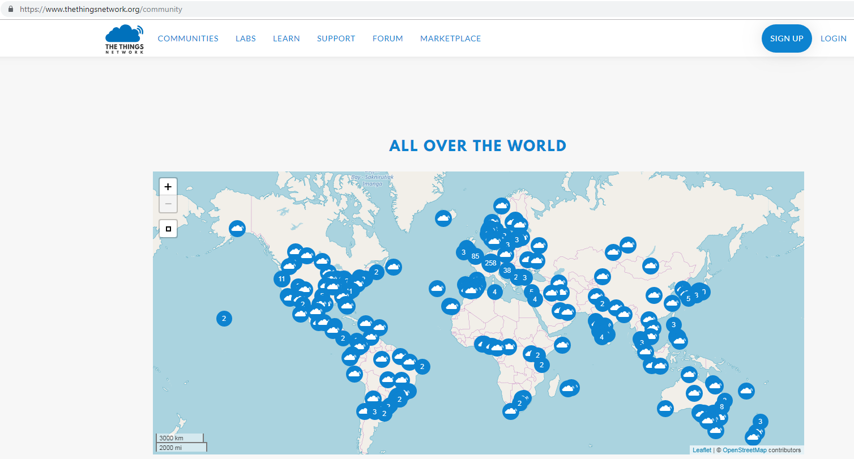
Smart City & Infrastructure Cloud Solution - LoraWAN

Slide 14
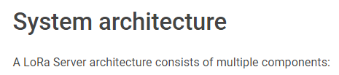
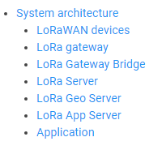
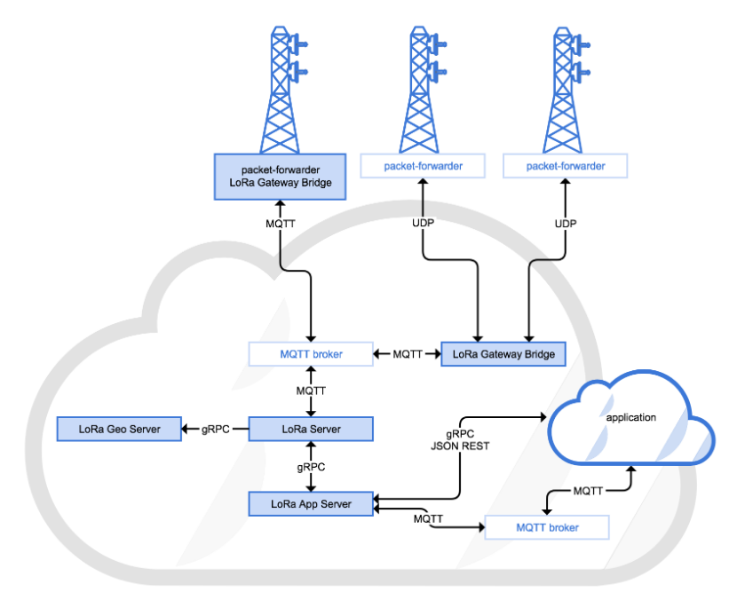
Smart City & Infrastructure Cloud Solution - LoraWAN

Slide 15
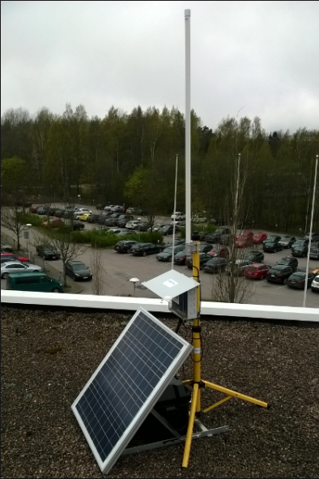
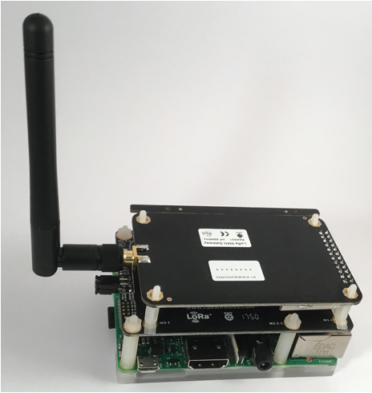
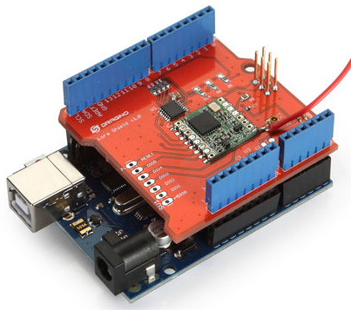
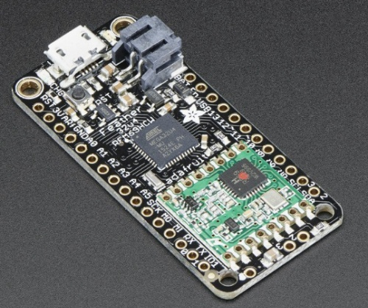
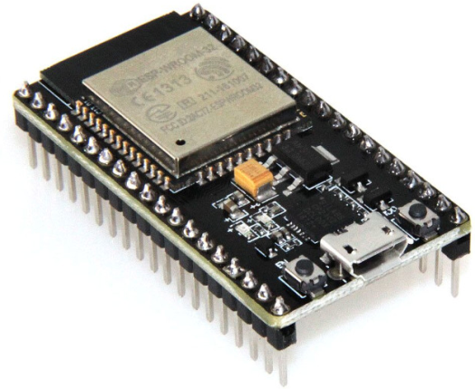
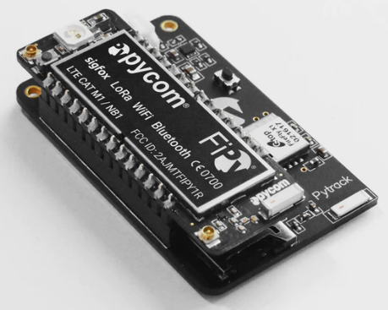
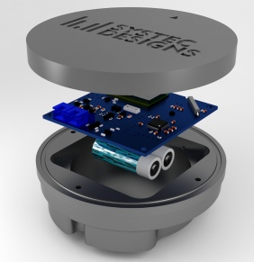
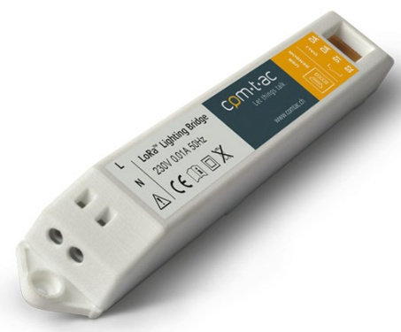
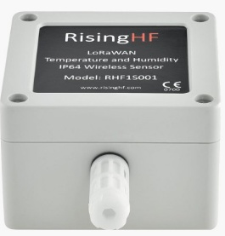
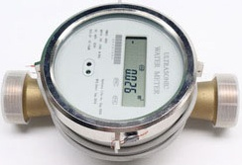
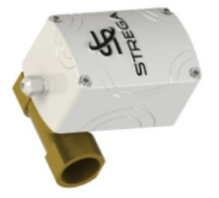
Smart City & Infrastructure Cloud Solution - LoraWAN
Industrial Grade Kerlink GW
DIY GW using Raspberrypi
DIY Nodes
Commercial Products
Parking Sensor
Lightning Bridge
Temp/Humidity Sensor
Gas Meter
Water Valve

Slide 16
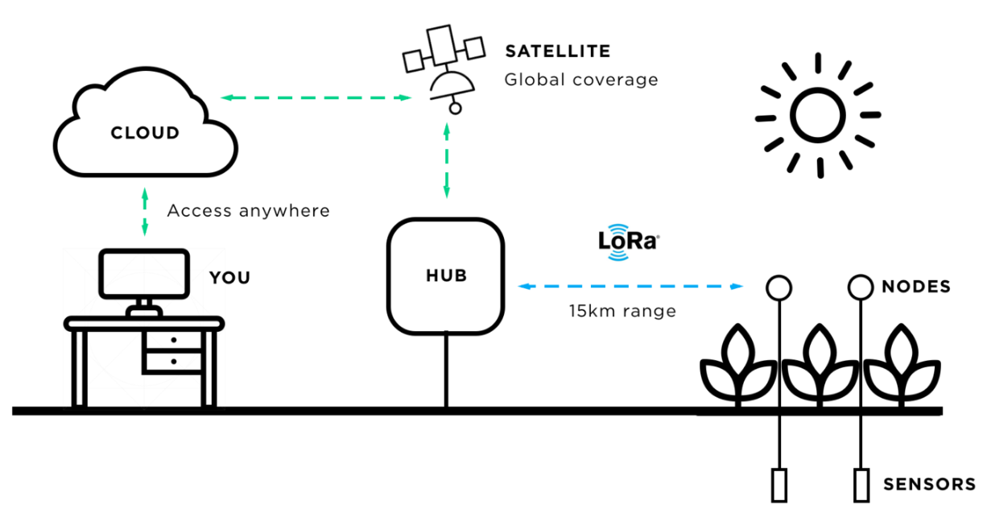
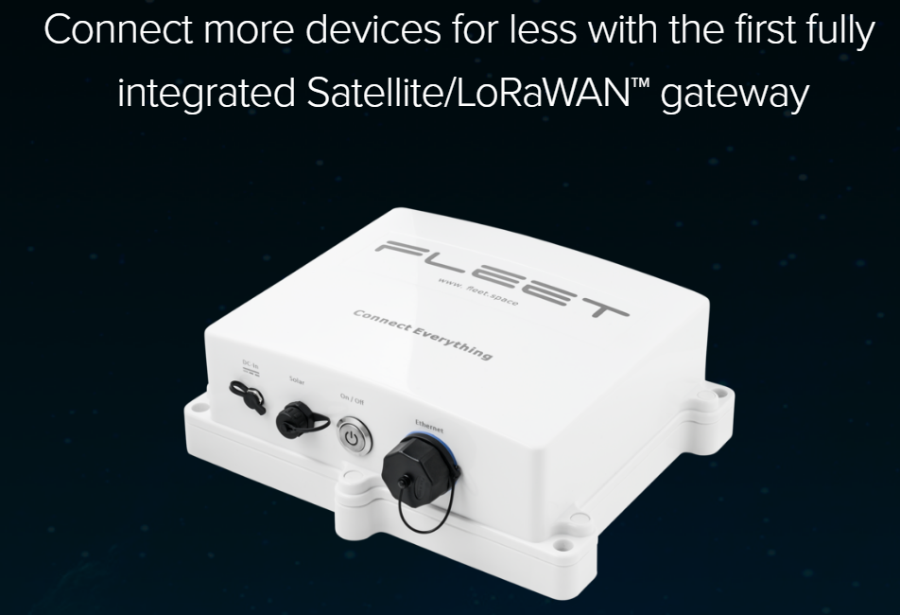
LoRaWAN Satellite Connectivity
www.fleet.space
Based in Adelaide, South Australia, FLEET are experts in remote connectivity systems.
FLEET specialize in Providing low-cost satellite based connectivity for Industrial Internet of Things applications. SATELLITE + LORAWAN
Connect thousands of things anywhere in the world.

Slide 17
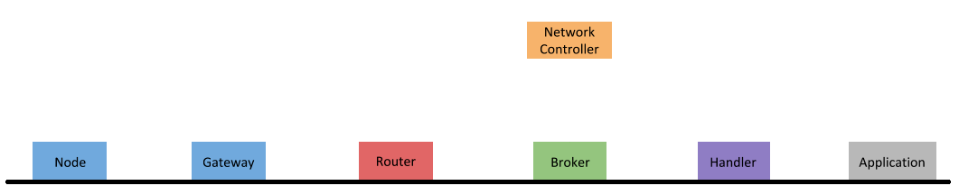

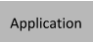
LoRaWAN – Packet Flow
Lora WAN packets
with metadata
Encapsulated in JSON over UDP
Lora WAN on
Lora RF
MQTT : 1883
MQTT : 1883
MQTT : 1883
MQTT : 1883

Slide 18
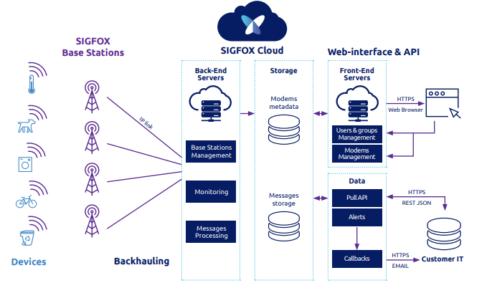
Smart City & Infrastructure Cloud Solution - SigFox
www.thinxtra.com
www.sigfox.com
Sigfox is a French global network operator founded in 2009.
Thinxtra is a SigFox operator empowering the Internet of Things LPWA networks in Australia, New Zealand and Hong Kong.
Thinxtra is a public company backed the CEFC (Clean Energy Finance Corporation), an Australian Government fund.

Slide 19
Cellular IoT Connectivity
Cellular LTE Cat M1 | NB-IoT Network
Bi-directional, power-efficient & provides extended coverage via existing cellular networks. It’s managed by major telecommunications carriers such as Telstra, Spark, Optus & Vodafone.
LTE Cat M1: 3GPP standard for low power application reusing most LTE technology concepts.
Cat M1 is well-suited to applications that use small amounts of data, providing them with extended range and long battery life.
NB-IoT: 3GPP new standard specially designed for IoT applications. It is very low power, excellent for indoor and deep indoor applications, reduced asset mobility and easy to deploy.
Narrowband IoT is better suited to applications sending smaller, more infrequent amounts of data, such as Agricultural moisture sensors or livestock tracking devices.

Slide 20
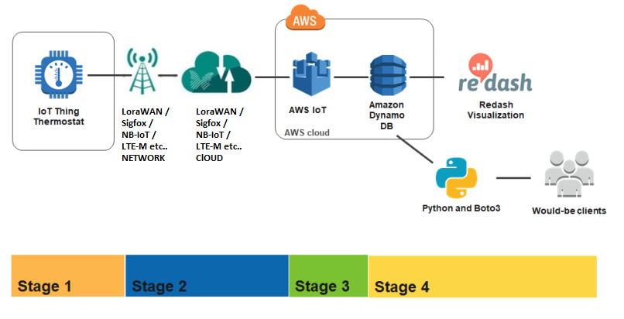
IoT Cloud/Architecture Platform - AWS
AWS IoT Device Gateway enables devices to communicate securely and efficiently with AWS IoT.
With this gateway, even things with different protocols can communicate with each other.

Slide 21
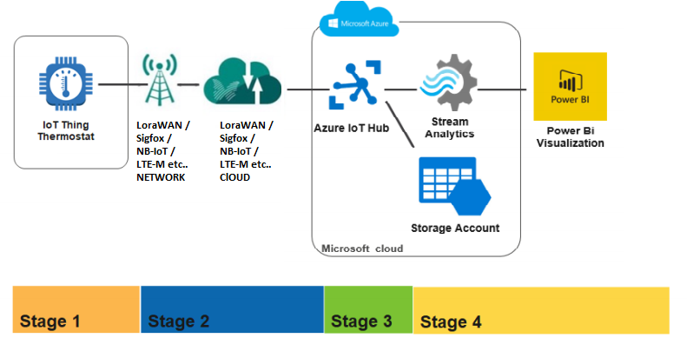
IoT Cloud/Architecture Platform - Azure
The Azure IoT Hub service allows bi-directional communication between the devices and the Microsoft IoT Platform.
Architecture after Azure IoT hub differs with other cloud providers.

Slide 22
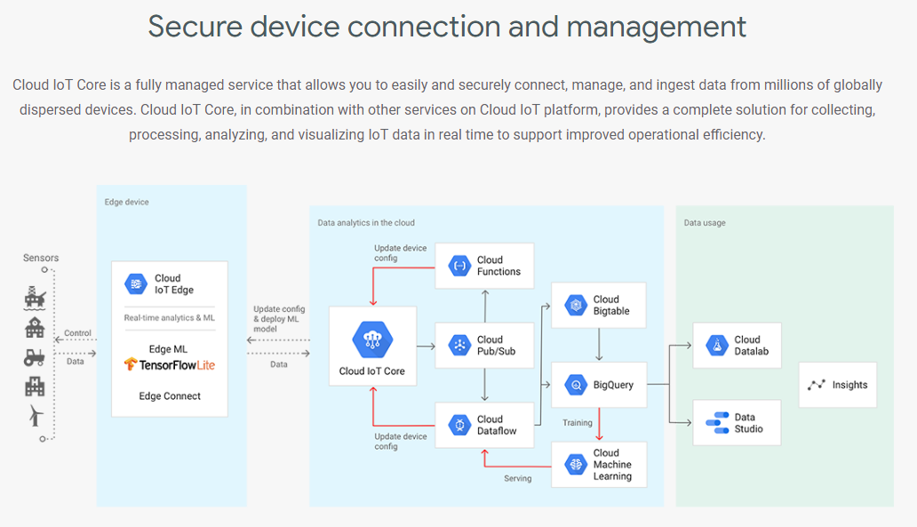
IoT Cloud/Architecture Platform - Google

Slide 23

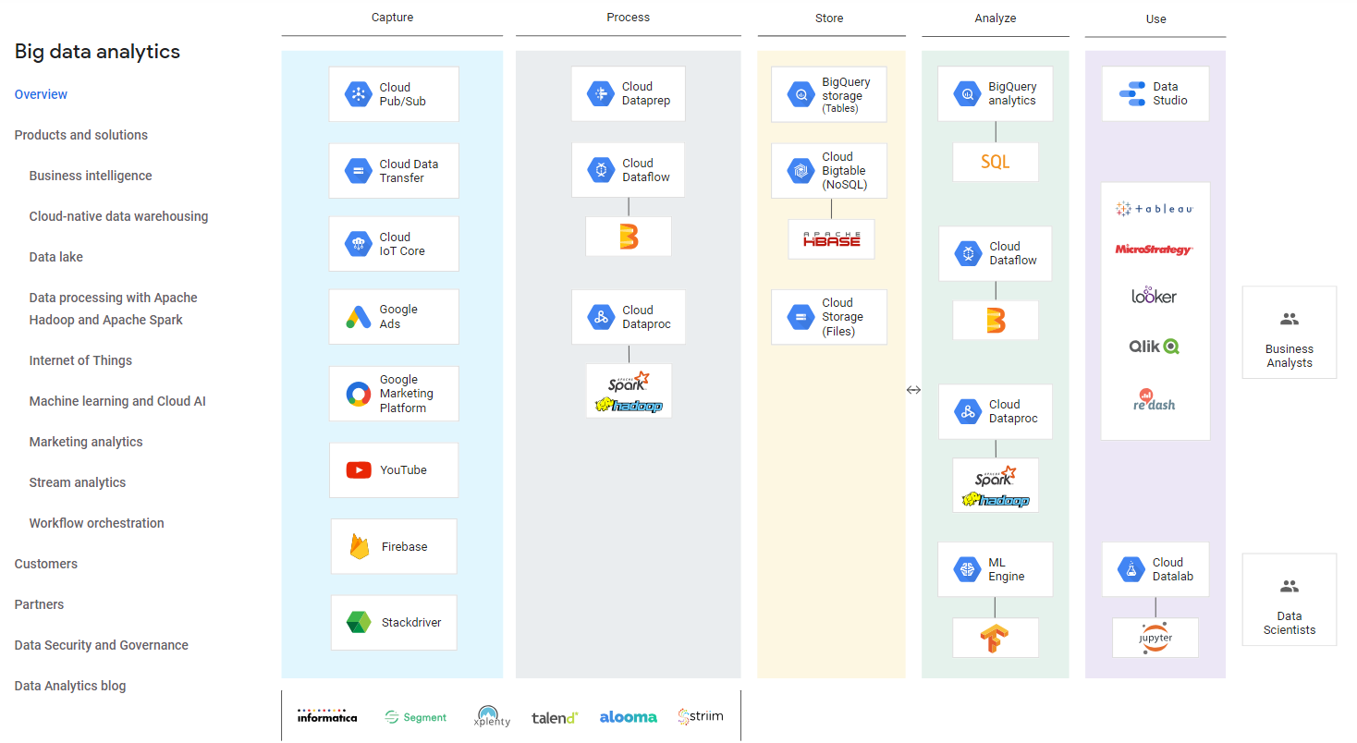
IoT Cloud/Architecture Platform - Google
CodeLab is a good way to understand traffic flow and other components virtually.
Youtube Video Link gives you good overview how it works.
https://www.youtube.com/watch?v=7kpE44tXQak

Slide 24
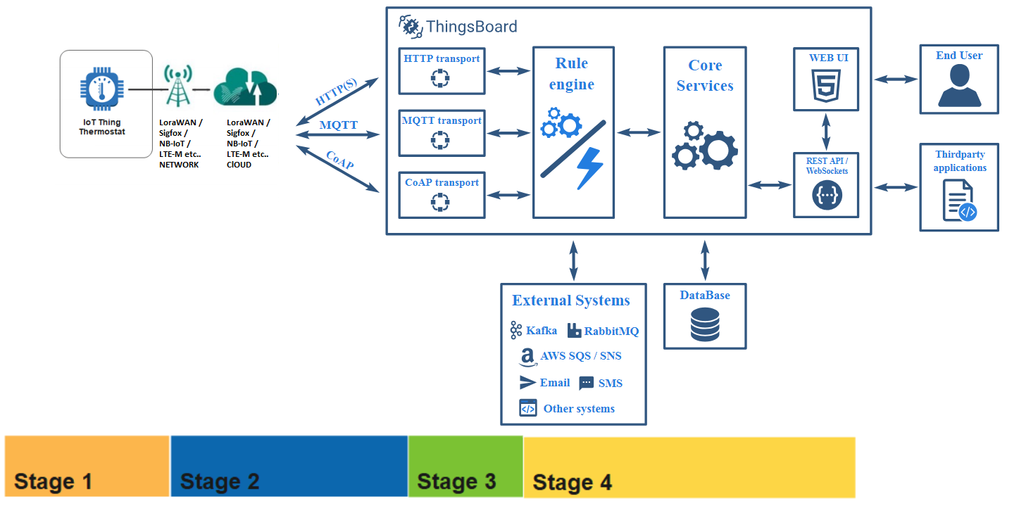
IoT Cloud/Architecture Platform – ThingsBoard (Open Source)
ThingsBoard is an open-source IoT platform for data collection, processing, visualization, and device management.
ThingsBoard enables rapid development, management and scaling of IoT projects.
It provide out-of-the-box IoT cloud or on-premises solution that will enable server-side infrastructure for any IoT applications.

Slide 25

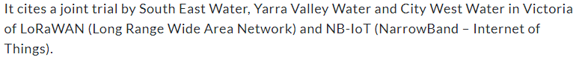



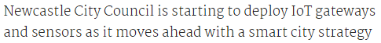

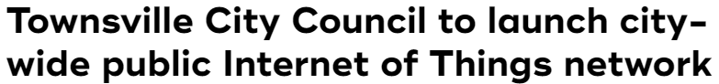

IoT – Things Happening in Australia

Slide 26
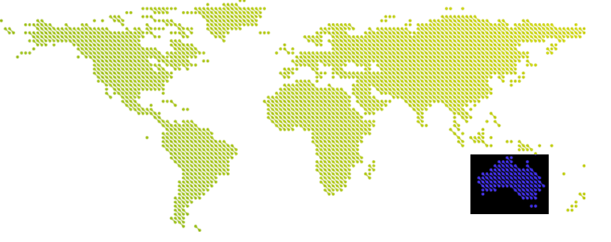
IoT, LPWAN, Data Analytics
Let us Innovate

